Slide 1

Agile Transformation in Distributed World

Slide 2
Agile Models
Collocated
      Teams are isolated across geographies
      OT Examples : Housecalls
Distributed (offshore QA – Onshore Dev)
      Scrum teams are isolated across geographies and integrated by a Scrum of Scrums that meet regularly across geographies
      OT Examples : Healthstate, Health Score
Distributed (Mixed Dev and QA at both onshore - offshore)
      Cross Functional Scrum Teams with members distributed across geographies
      OT Examples :DHN, M&R Portals

Slide 3
Collocated (Housecalls)
Onsite
Product Owner develops backlog user stories
Groom user stories & set priorities
Participate & advise team on daily stand up meetings
Offshore
Involve in user story grooming sessions & planning
Understand requirements, write test cases, develop
System Integration i.e., Sprint test execution
Offshore Dev & QA Teams co-located
Dev Team
QA team
Offshore Dev & QA teams co-located
Offshore shift timings are 11:00 am to 8:30 pm
More productivity, less TAT, highly preferred

Slide 4
Distributed - Onshore dev offshore QA model (Healthstate, Health Score )
Onsite
Product Owner develops User stories & builds backlog
PO grooms user stories & set priorities
PO Participates & advise scrum team in daily stand up meetings
Scrum Team participate in Sprint planning meeting
Development of user stories i.e., breaking into tasks
Code Integration, Unit testing
Offshore QA
Participate in user story grooming sessions & sprint planning
Understand requirements, write test cases & develop
System Integration i.e., Sprint test execution
Offshore QA teams co-located
Offshore shift timings 11:00 am to 8:30 pm (IST) & QA teams are flexible for 2pm to 12 Noon (IST) shift if required
Moderate benefit, need to adjust with timing, loose in productivity and more TAT

Slide 5
Distributed – Dev, QA both at onshore & offshore (DHN, myEasybook)
Onsite
Product Owner develops backlog user stories
Groom user stories & set priorities
Participate & advise team on daily stand up meetings
Offshore
Involve in user story grooming sessions & planning
Understand requirements, write test cases, develop
System Integration i.e., Sprint test execution
Offshore Dev & QA Teams distributed
Dev Team
(Gurgaon, Hartford, Detroit)
QA team
(Hyderabad, Hartford, MN, NJ)
Offshore Dev & QA teams distributed
Offshore shift timings are 11:00 am to 8:30 pm
More realistic approach, time zone challenges, More collaboration required, mostly applied approach

Slide 6








Agile Delivery Models
Agile Delivery Models
Co-located
Feature Driven Team
Co-located
Distributed
Component Driven Team
Component Driven Teams
Feature Driven Teams
Feature 2
Feature 3
Feature1
Functional Distribution
Feature1
Feature 2
Feature 3
Front End Team
Front End
Team
Distribution by Roles
Back End Team
Back End
Team
Data base Team
Data base
Team
Notes:
There is an opportunity to move from Component to feature driven teams based on the technology and domain knowledge. Component teams are focused towards owning specific components. Feature driven teams cut across various components.

Slide 7
Nuances of Agile Models
Component
Feature Driven
Nuances
Speed to Market
Incremental Delivery
Quality / Predictability
Business IT Alignment
Ability to mange Changing Priorities
Project Visibility
Highly
Favorable
Highly
Un-Favorable

Slide 8
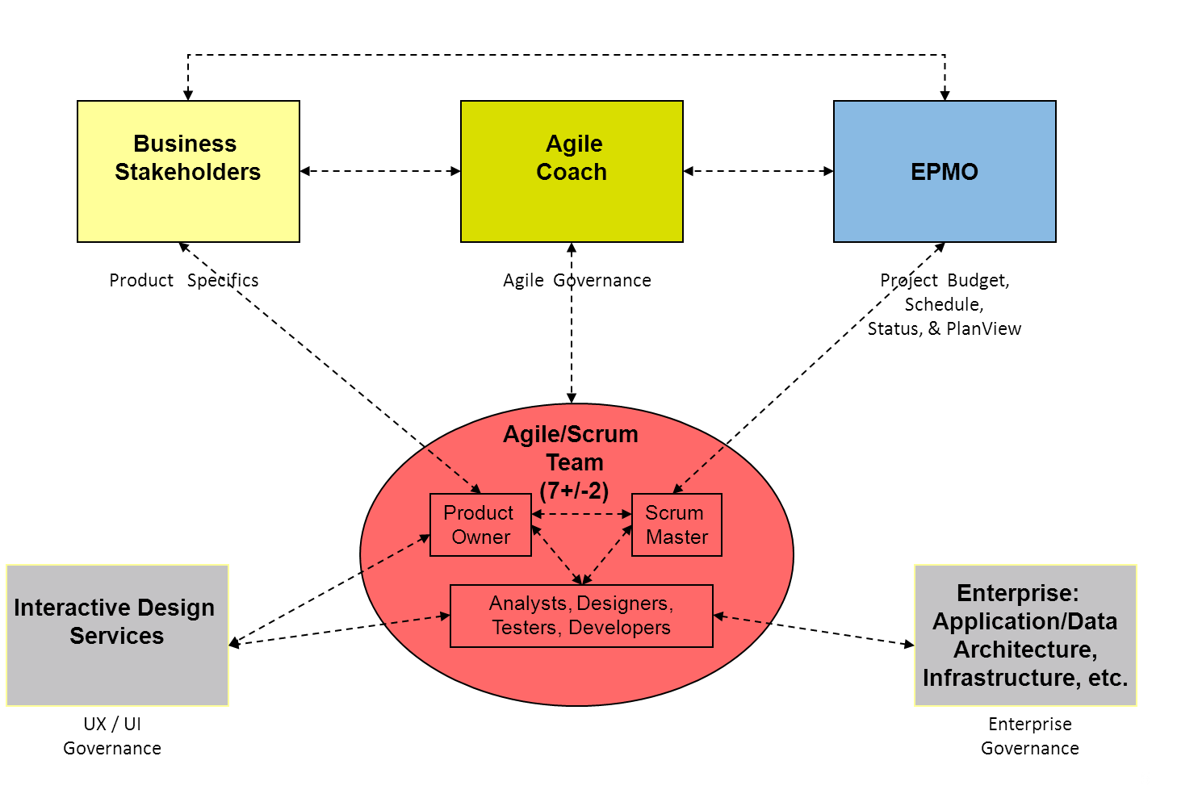
Agile/Scrum Team Structure & Operating Model

Slide 9
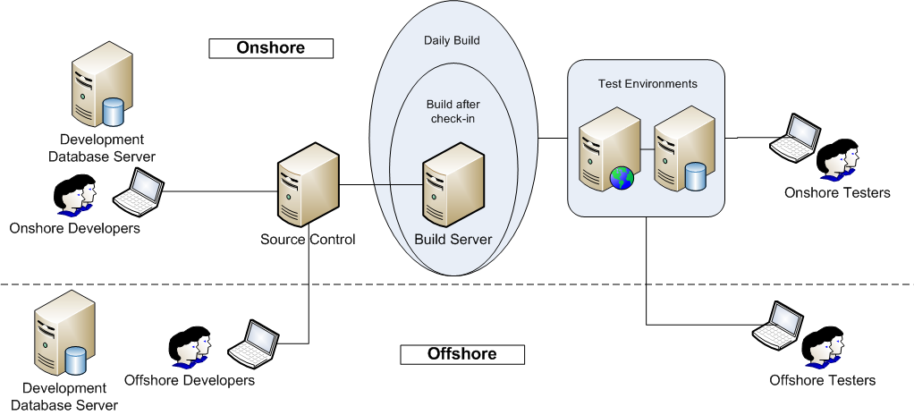
Onshore & Offshore – Communication/ Collaboration
Daily Scrum, Weekly Show & Tell, Sprint review & retrospectives meetings…
Teams are distributed across the geographies. Example, India office
we have various Offsite locations (Hyd1, Hyd2, Gurgaon, Noida etc.) The teams also located both in India and USA locations
Notes:
Important to have consistent working practices onshore and offshore
Multiple teams Check into one mainline branch
Continuous integration was onshore Build the entire system

Slide 10
Leveraging Offshore Advantage
High - “Evolving/ Emerging” Requirements
All On-shore
Offshore Agile
Need for Flexibility
Low - “Known/ Given” Requirements
All Offshore
Low
High
Need for Dev Speed (for given $$ budget)
Confidential

